Slide 1
ERASMUS + LET’S BE CREATIVE AND LEARN WITH ART” CREARTIVITY

Slide 2
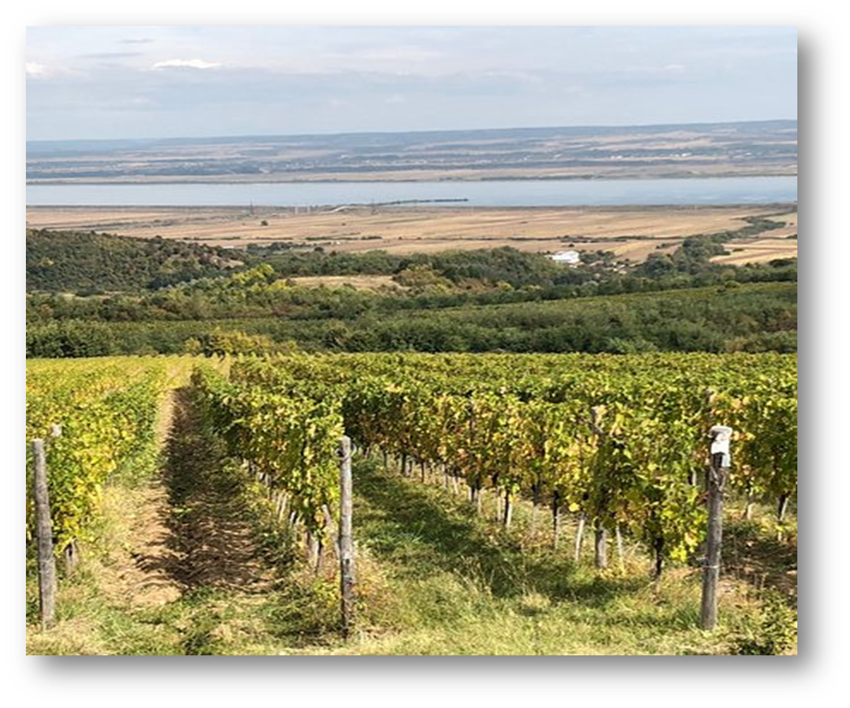
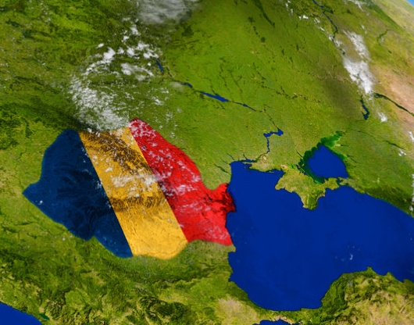
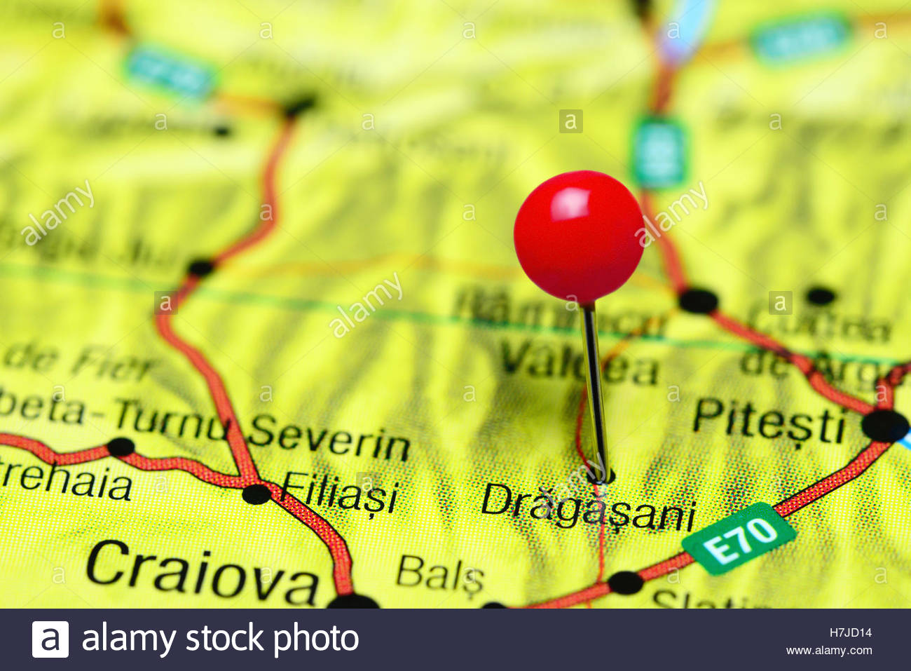
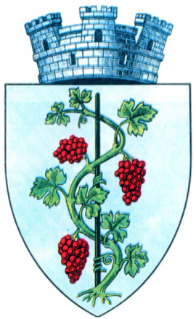
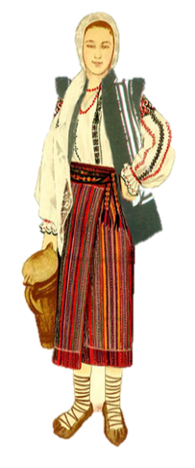
WE ARE FROM ROMANIA,
A COUNTRY FROM THE SOUTH-EAST OF EUROPE.
WE LIVE IN DRAGASANI,
A SMALL TOWN IN THE SOUTH OF THE COUNTRY, WELL-KNOWN FOR ITS WINE.

Slide 3
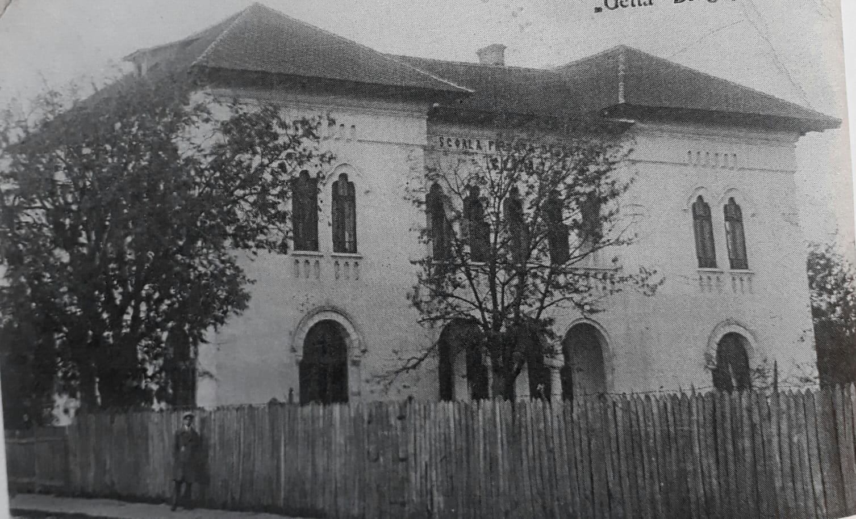
1912- IN DRĂGĂȘANI A NEW SCHOOL WAS CREATED, NAMED ”URBAN SCHOOL FOR GIRLS”.
It was a school without a building of its own, with only two teachers and thirty-six pupils in four classes

Slide 4
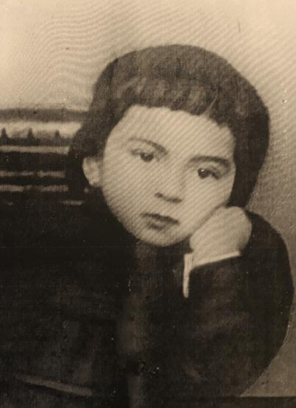
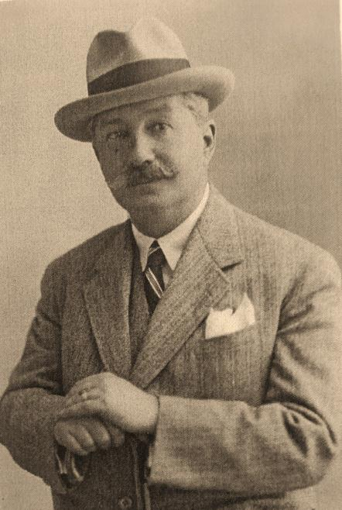
In 1922, Gh. Luculescu, a well-known and respected local businesman, owner of a vineyard, began the building of a school in the memory of his adoptive daughter, Getta Costache.
After four years, he finished the new school called ‘’PRIMARY SCHOOL FOR GIRLS GETTA” and this was the name of the school for twenty years.

Slide 5
DIFFERENT NAMES OF OUR SCHOOL OVER THE YEARS: ELEMENTARY SCHOOL 1ST MAY, EIGHT YEARS GENERAL SCHOOL
TEN YEARS GENERAL SCHOOL, NO. 2,
THE SCHOOL WITH I-VIII CLASSES, NO 2.

Slide 6
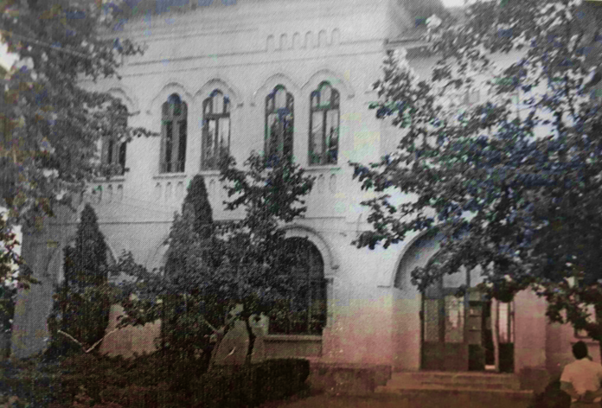
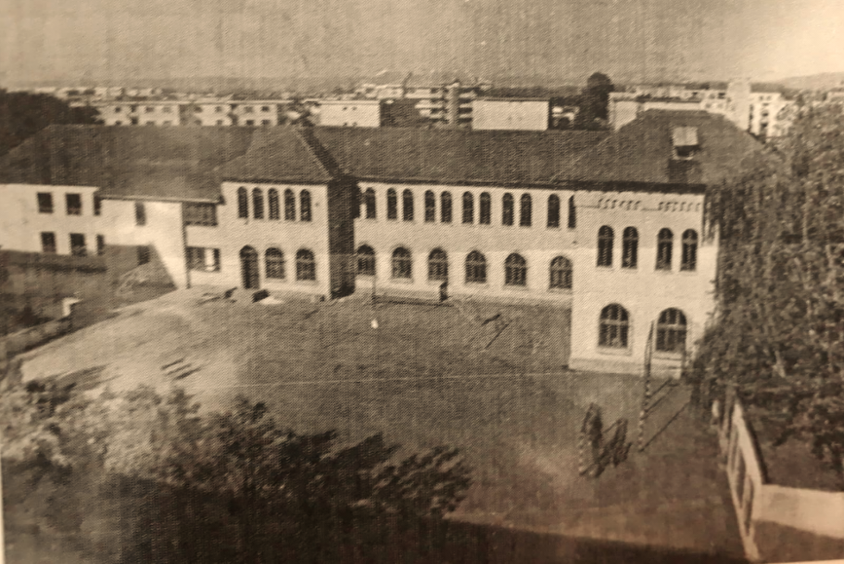
In 1967, our school extended with a new buiding made of five classrooms: four classes and a teacher’s lounge.
After that there were new additions: six classrooms and two other buildings, a physics lab and a chemistry lab.

Slide 7
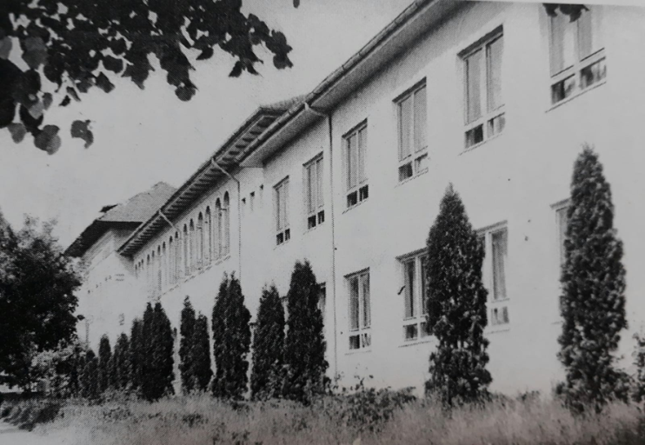
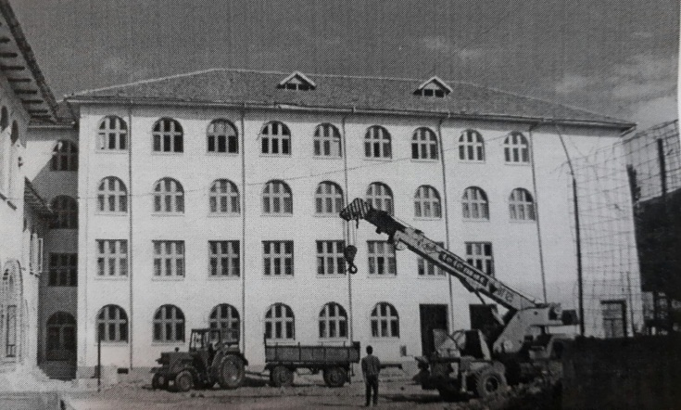
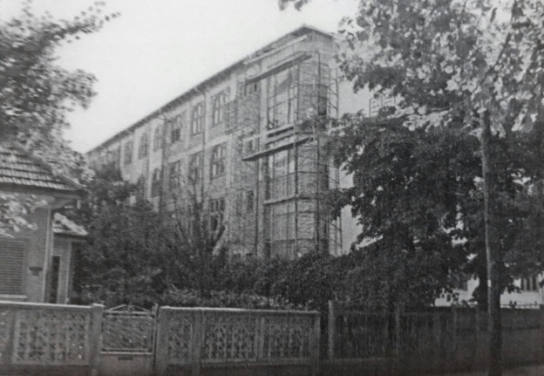
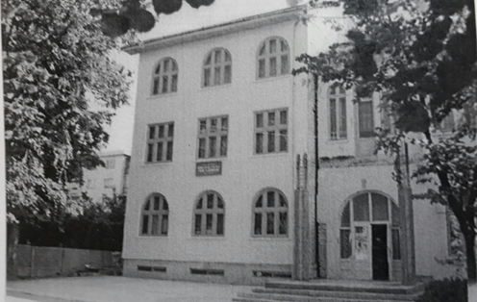
In 1977 a terrible earthquake hit Romania and the school building needed consolidation. Later, in 1993 the old building was demolished and replaced with a new one new building with three floors and 16 rooms, 2 labs, a gym, a festivity hall, a library, a teachers’ room, the Principal room and the Secretariat.

Slide 8
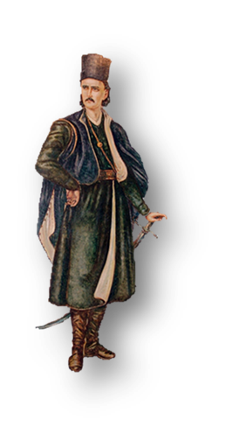
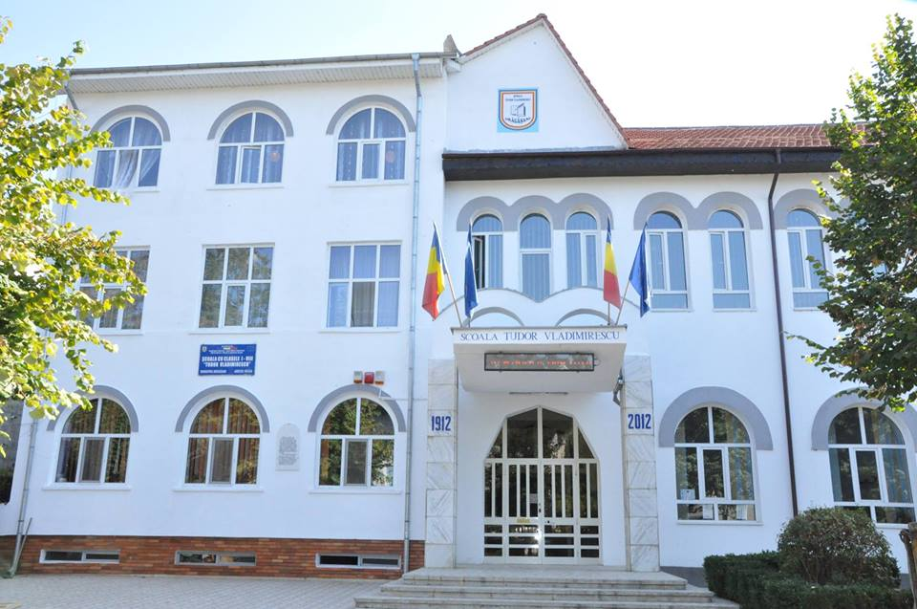
Since 1995, our school has been named Tudor Vladimirescu,
after a great national hero who stopped in our town for a while.
In 2012, a new modern building body was added on the east side.
.

Slide 9
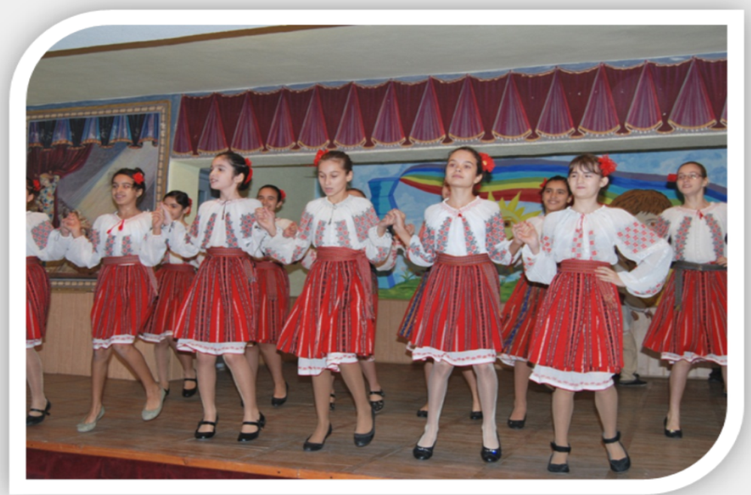
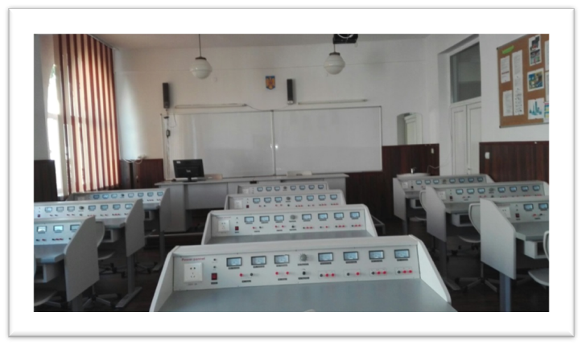
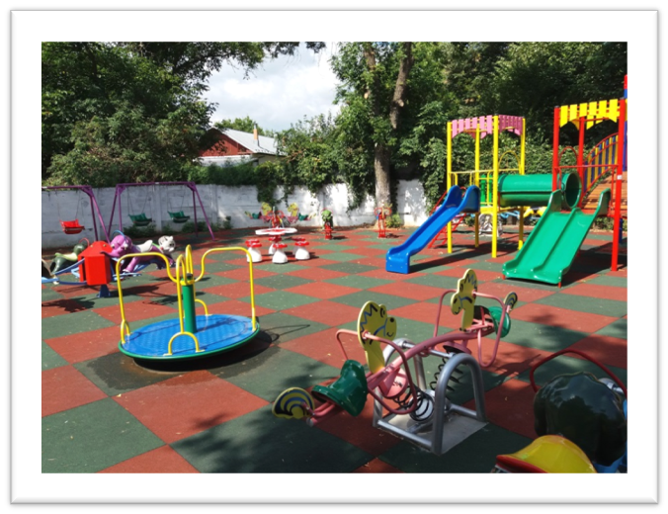
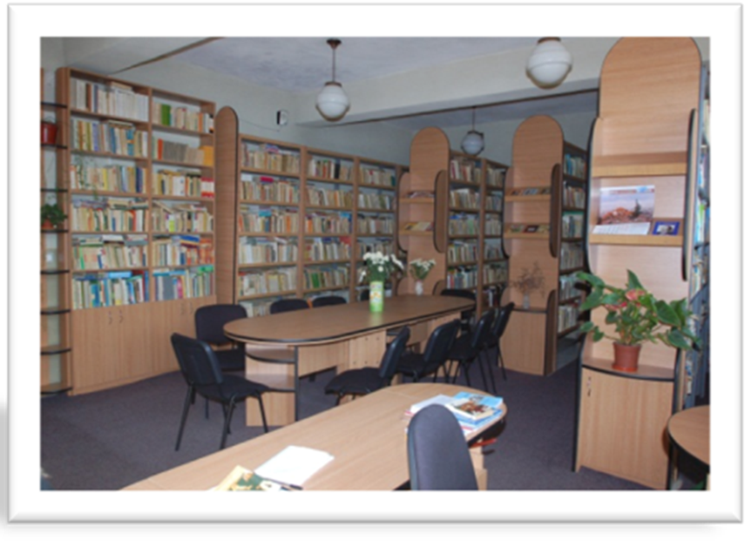
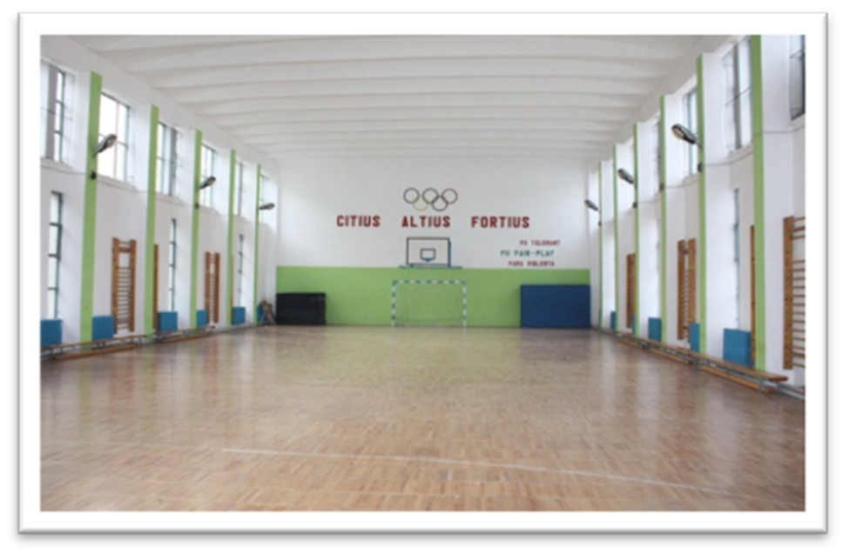
Nowadays, Tudor Vladimirescu School has over 1000 pupils (kindergarten, primary and lower secondary).
There are 25 classrooms, modern labs, a gym, a festivity hall and a small cafeteria.

Slide 10
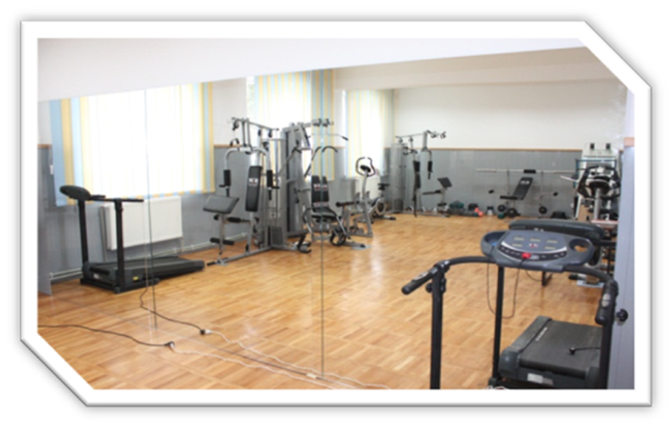
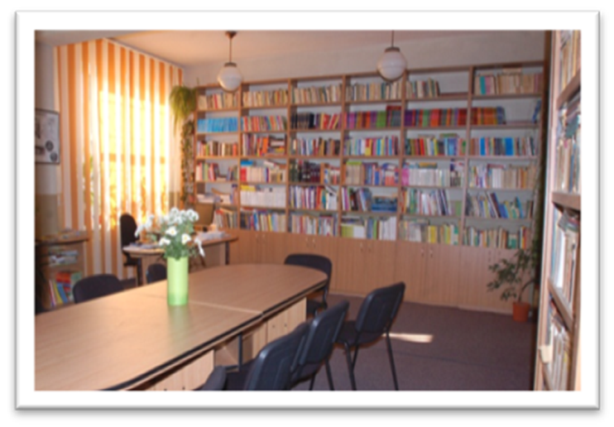
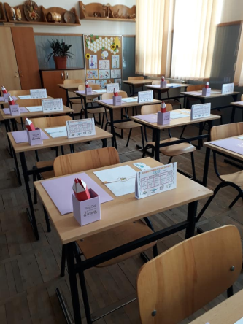
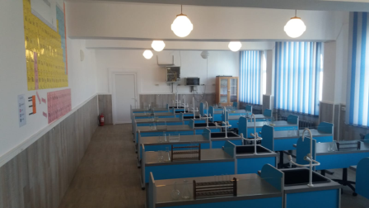
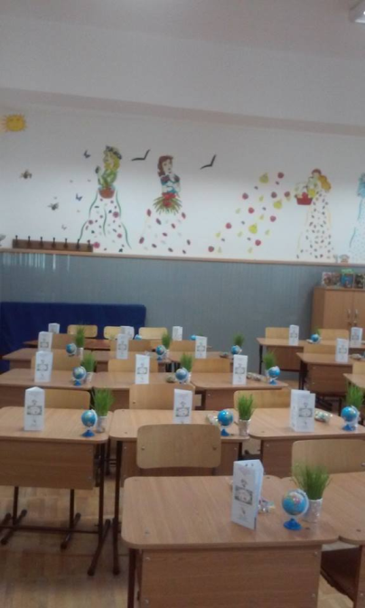
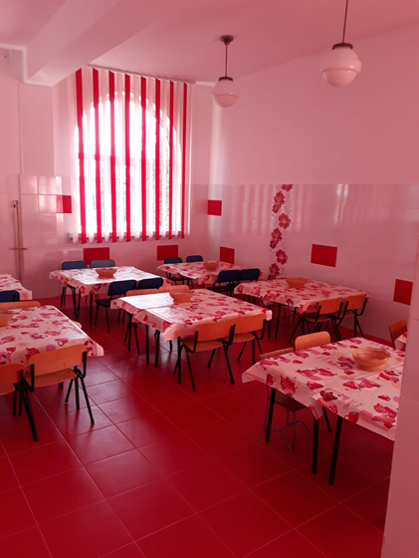
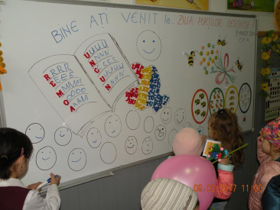
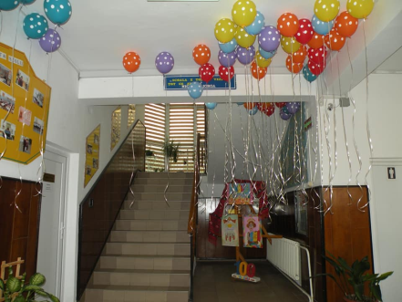

Slide 11
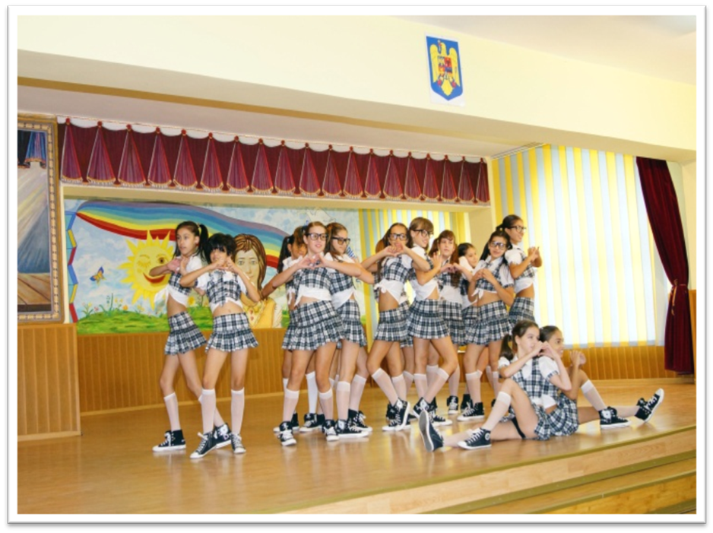
THANK YOU !

